Slide 1
HR ANALYTICS
Project Done By Gr:3
Gayatree Panda
Sidhartha Donapati

Slide 2
We performed an analysis on HR data for employee retention having 50,000+ records and drawn KPI from it using Excel, My SQL also used visualization tools like Tableau and used Power BI to make dynamic dashboard.
We got some insights regarding attrition of employees with respect to department, monthly income, work life balance, years of promotion etc.

Slide 3
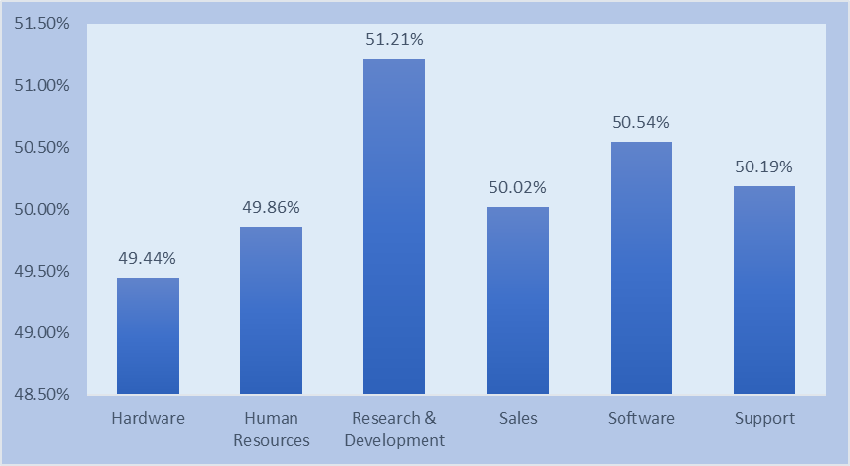
1. Average Attrition Rate For All Departments
The insights driven using excel is shown here:
Data shows that Research & Development department has highest attrition rate while hardware has lowest.
We can see salary hike is not the reason of attrition cause R&D department getting good percentage salary hike.
In this department attrition of Females are more.
In HR, software department attrition of male is higher than female, while in other department female attrition rate is higher than male.
One reason can be the manager they are working under.
Departments | Avg Attr_Rate
Hardware | 49.44%
Human Resources | 49.86%
Research & Development | 51.21%
Sales | 50.02%
Software | 50.54%
Support | 50.19%

Slide 4
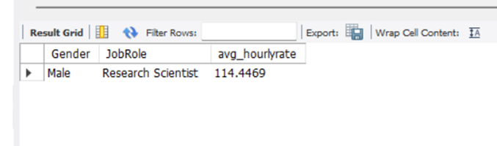
2. Average Hourly rate of Male Research Scientist
Syntax:-
select Gender, JobRole, avg(HourlyRate) as avg_hourlyrate FROM hr_1 where gender='male'and jobrole="research scientist";
The insights driven using my SQL is shown here:
Min hourly rate = 30
Max hourly rate = 200
AVG hourly rate of male research scientist is coming as 114.45
While for female its 115.9

Slide 5
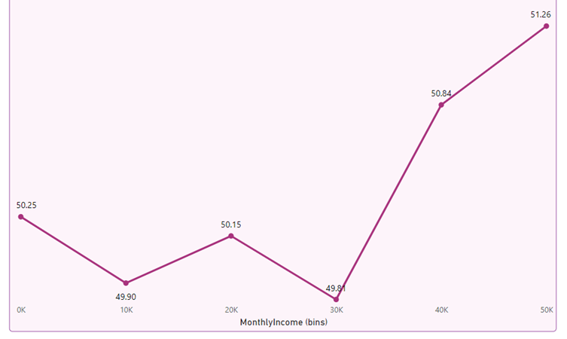
3. Attrition Rate Vs Monthly Income Stats
The insights driven using power bi is shown here:
Min salary =1001
Max salary = 50999
Maximum salary hike is for 20-30k salary bin.
Max attrition is from 40-50k salary bin.
That may be because they are getting better salary
option in other company for the same work.

Slide 6
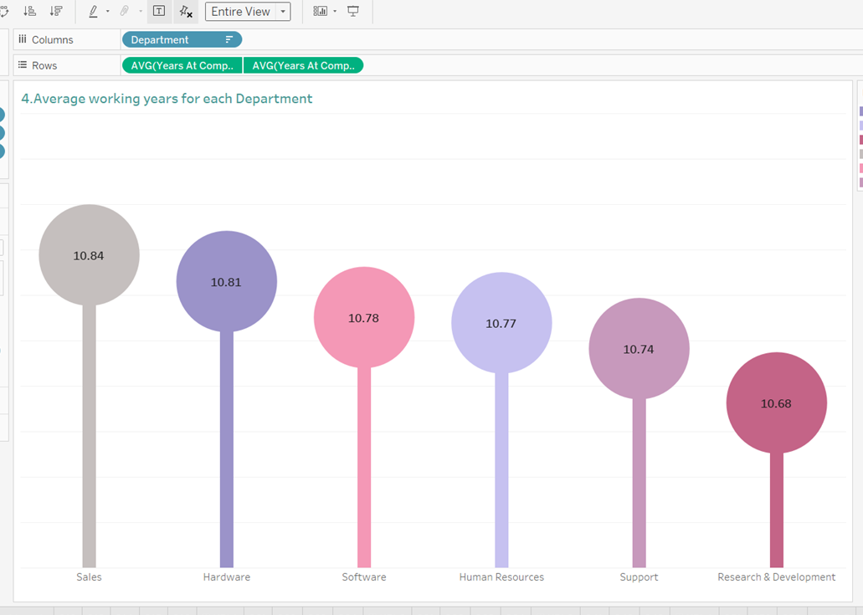
4. Average Working Years For Each Department
The insights driven using Tableau
is shown here:
Avg. working year for Sales department is highest and for R&D department its lowest.
We have to work on R&D department.

Slide 7
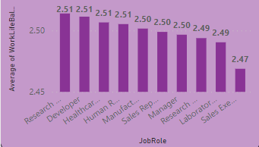
5. Job Role Vs Work Life Balance
The insights driven using Power BI is shown here:
We can see that the Research & Development Dept has excellent work life balance.
While Sales Executive Dept is having poor work life balance.
Employees from Sales Executive department are need better Work life balance.

Slide 8
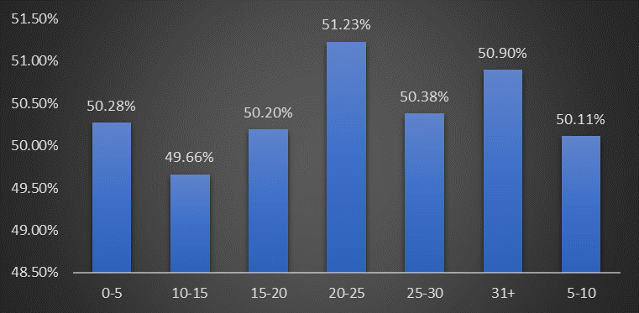
6. Attrition Rate Vs Year Since Last Promotion Relation
The insights driven is shown here:
The graph shows slight fluctuation for attrition for the employee who have got promotion recently.
While the employees who have not got promoted for more than 20 years they shows more fluctuation in attrition graph.

Slide 9
THANK YOU

